Slide 1

Detecting Distribution Shift on MNIST with VAEs
Roshanak Behrouz

Slide 2
Problem Statement
Can a VAE detect and characterize distribution shifts using reconstruction error and latent uncertainty?

Slide 3
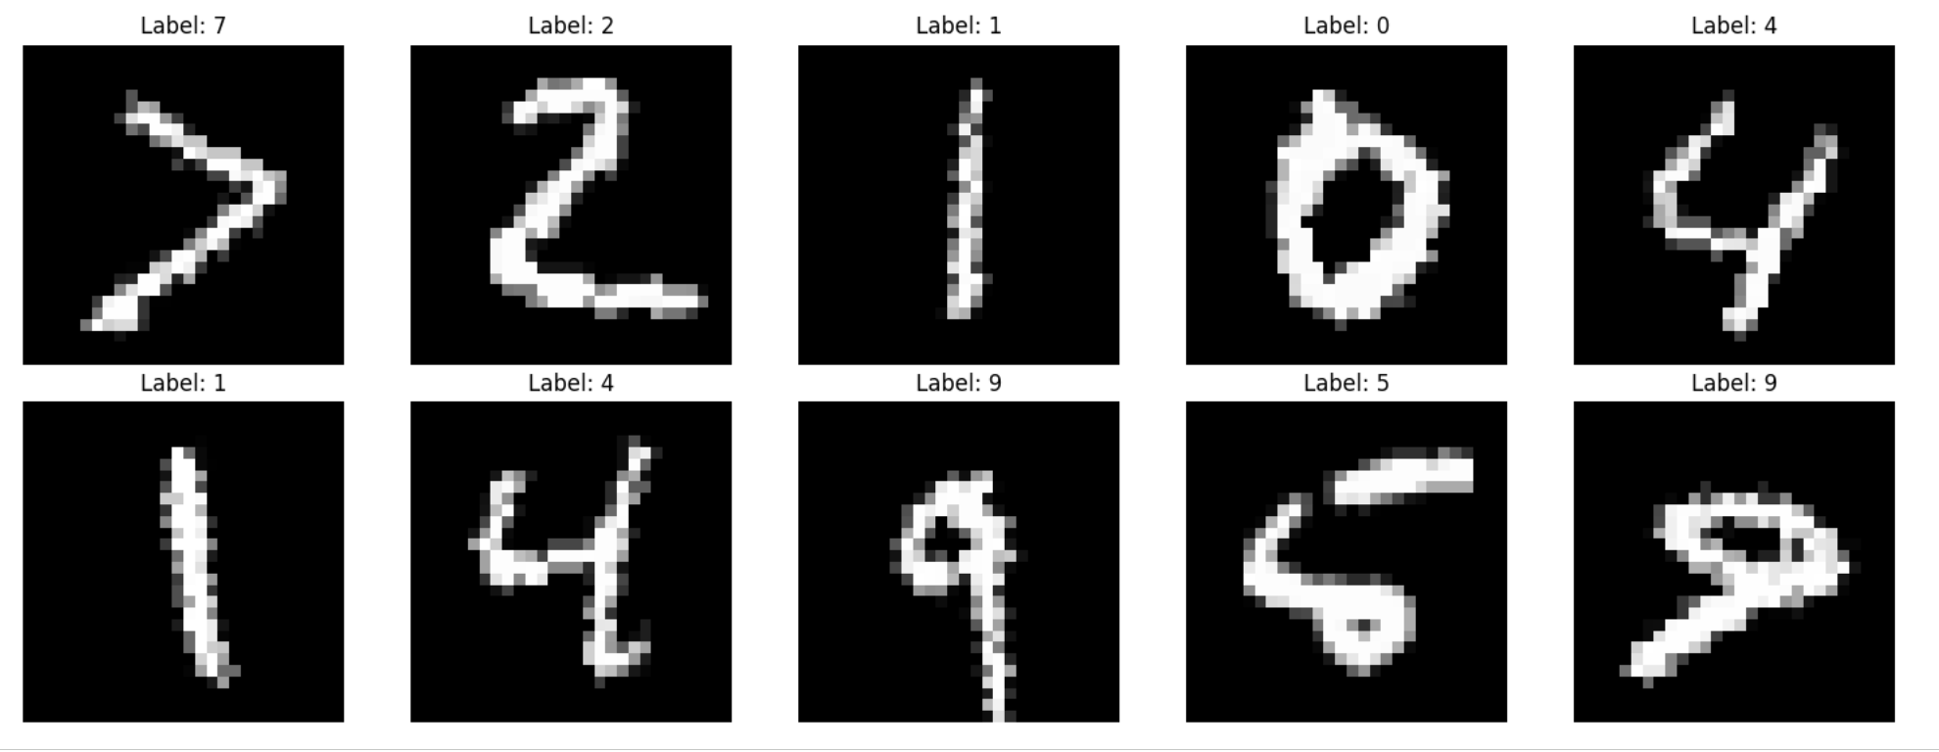
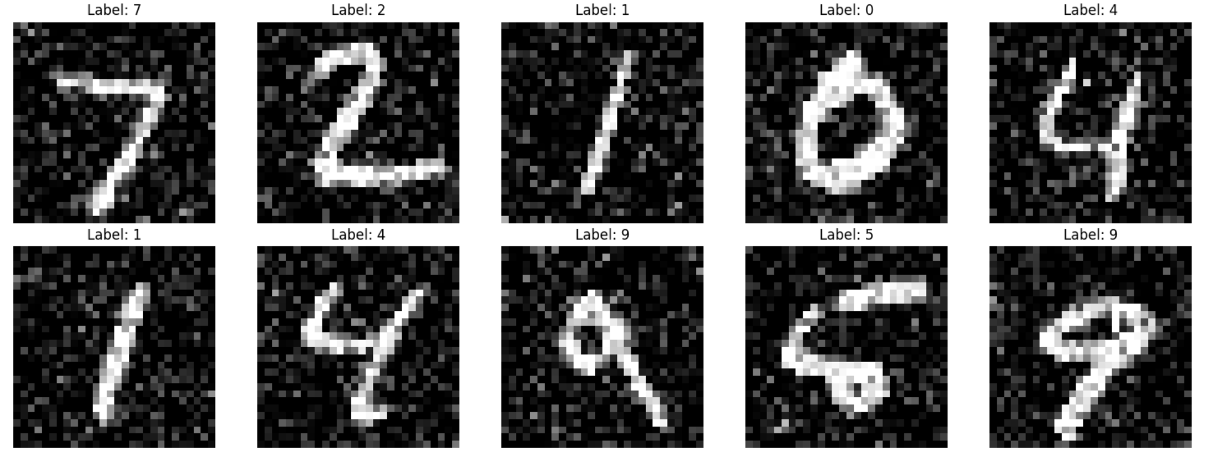
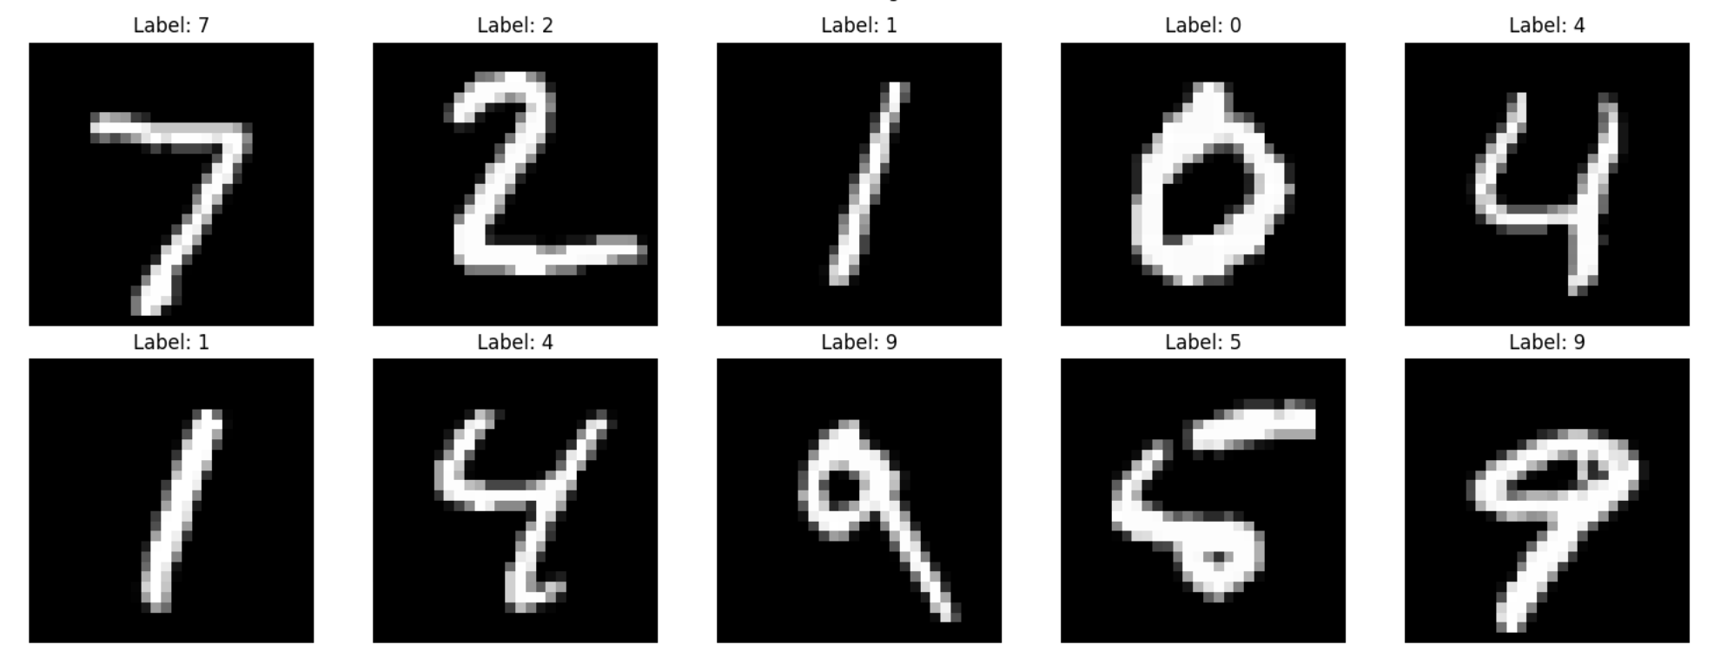
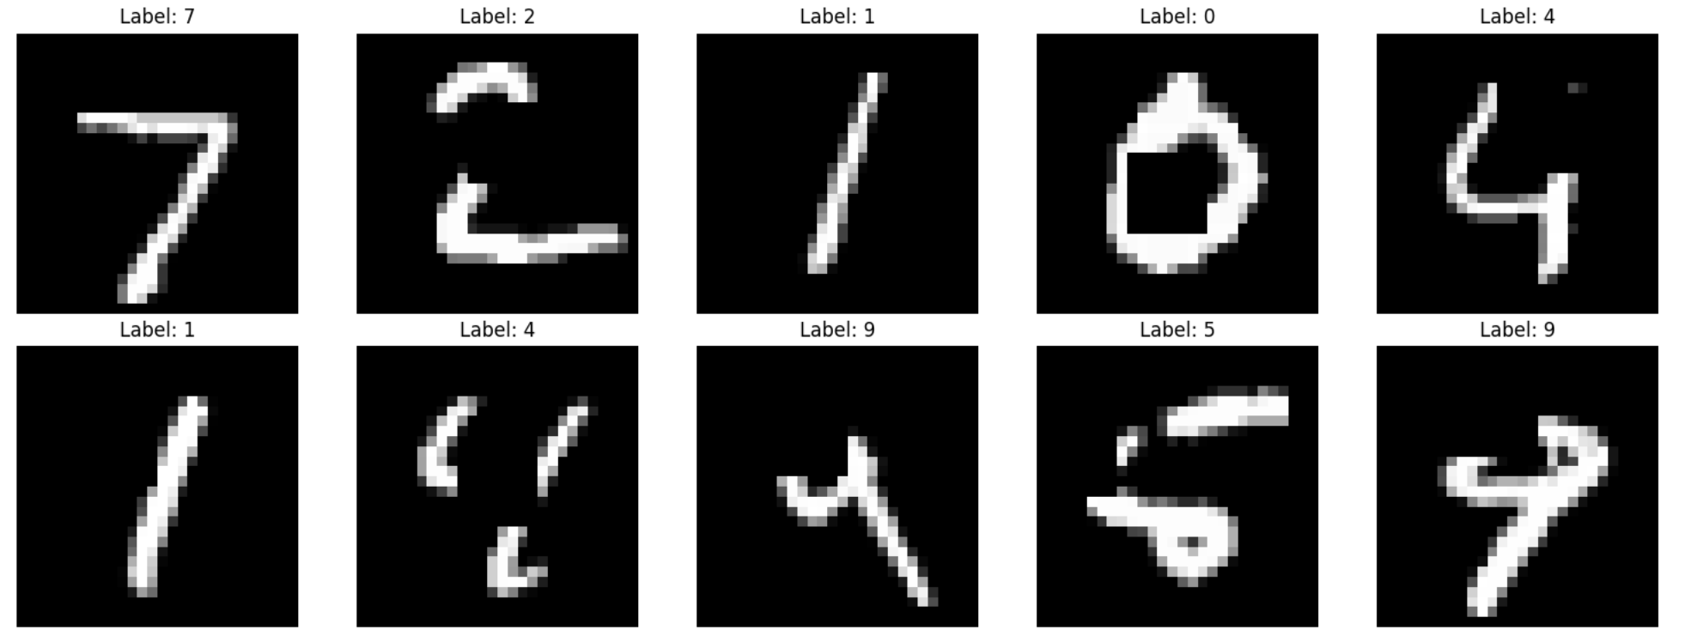
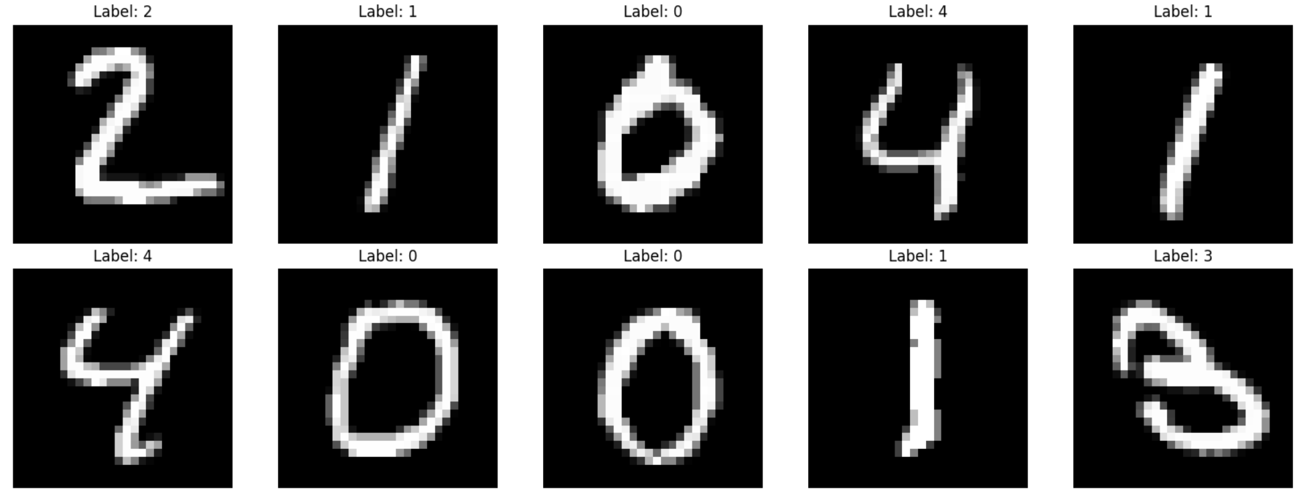
Experimental Design:
MNIST
28×28 grayscale digits
Train: 60k | Test: 10k
Distribution Shifts
Rotation (±30°)
Gaussian noise (σ=0.2)
Occlusion (8×8 block)
Label shift (digits 0–4)

Slide 4
Models compared
Convolutional Autoencoder, (CAE)
Fully-Connected VAE, (FC-VAE)
Convolutional VAE(β = 1), (ConvVAE )
Convolutional VAE(β = 4), (ConvVAE4 )

Slide 5
Comparison of Models
Feature | Conv-AE | FC-VAE | Conv-VAE
Input Shape | 3D Tensor: (1, 28, 28) | Flattened Vector: (784,) | 3D Tensor: (1, 28, 28)
Layer Type | Convolutional | Linear | Convolutional
Latent Logic | Deterministic (Fixed 𝓏) | Variational (µ, 𝜎) | Variational (µ, 𝜎)
Knowledge | Local (Spatial) | Global (Flat) | Local (Spatial)
Loss Function | Reconstruction Error | Recon + KL Divergence | Recon + KL Divergence

Slide 6
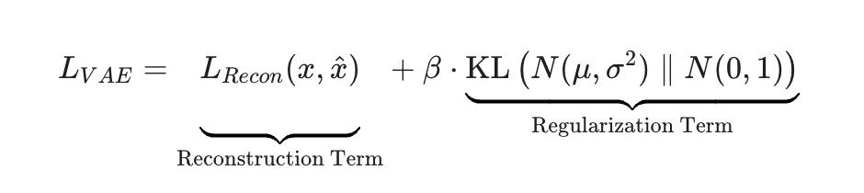
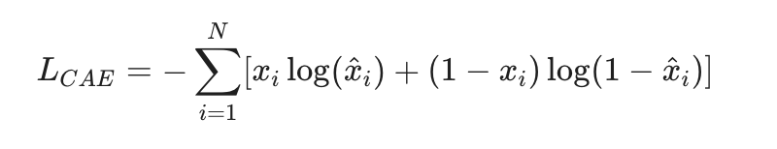
Loss Functions
Variational Autoencoder : ELBO
Convolutional Autoencoder

Slide 7
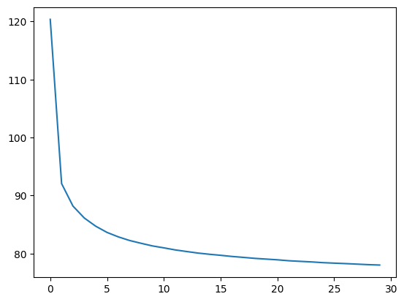
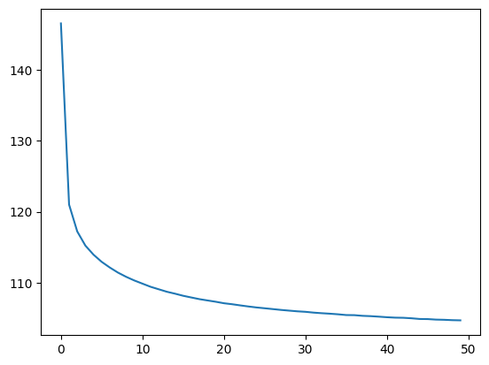
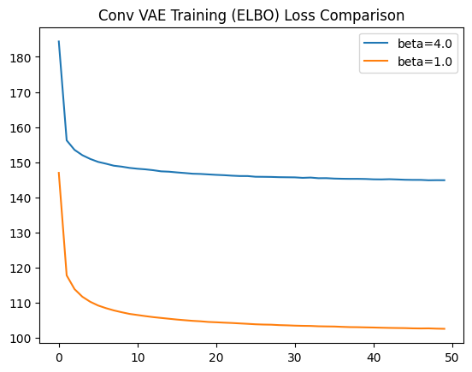
Training Loss Per Epoch (Average Loss Per Epoch)
CAE
FC- VAE
Conv VAE

Slide 8

Results

Slide 9
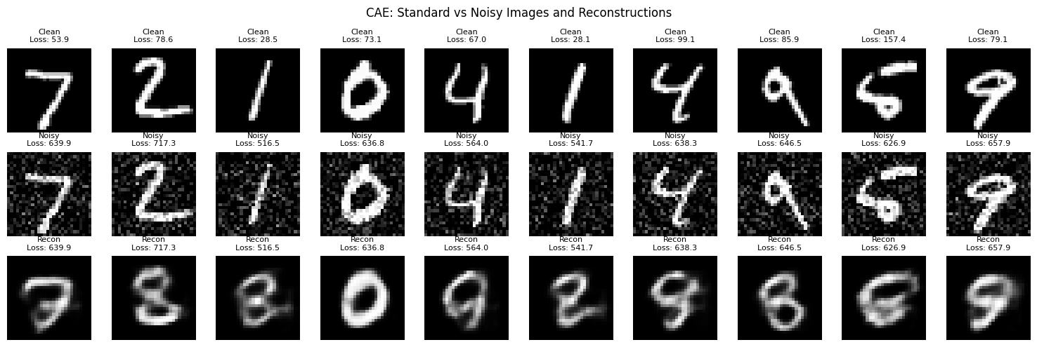
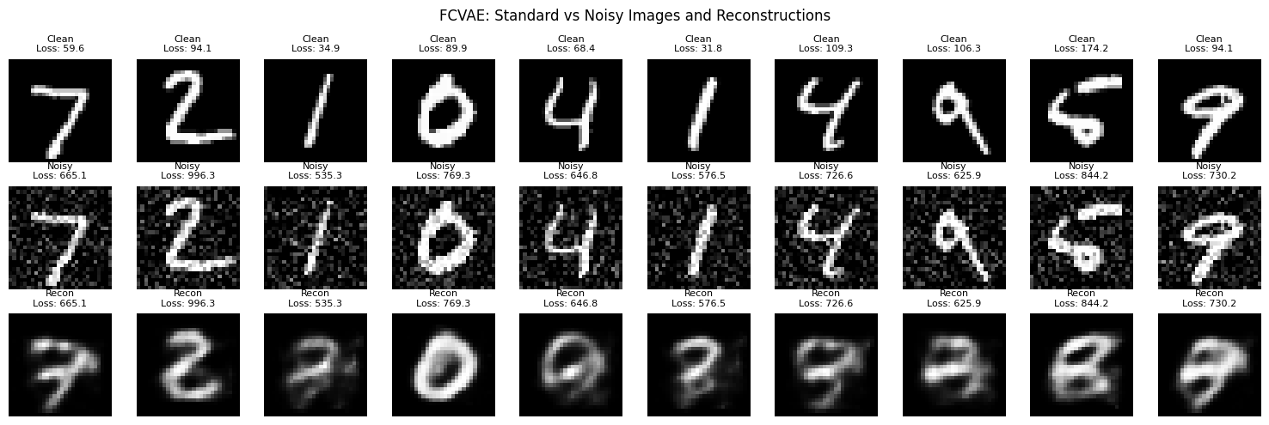
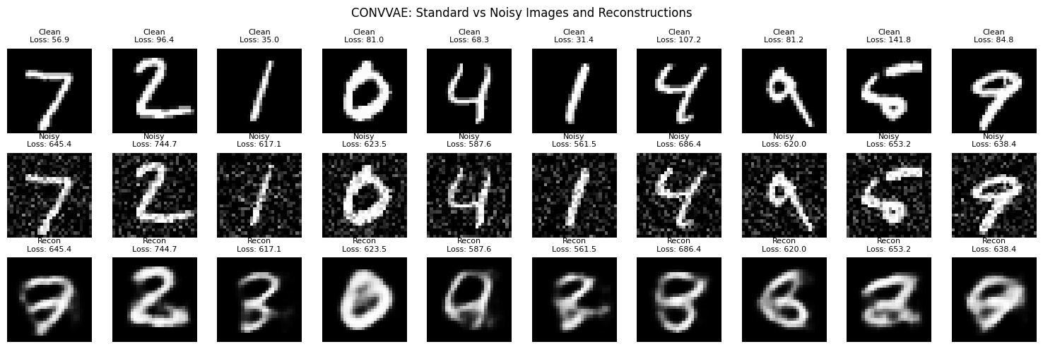
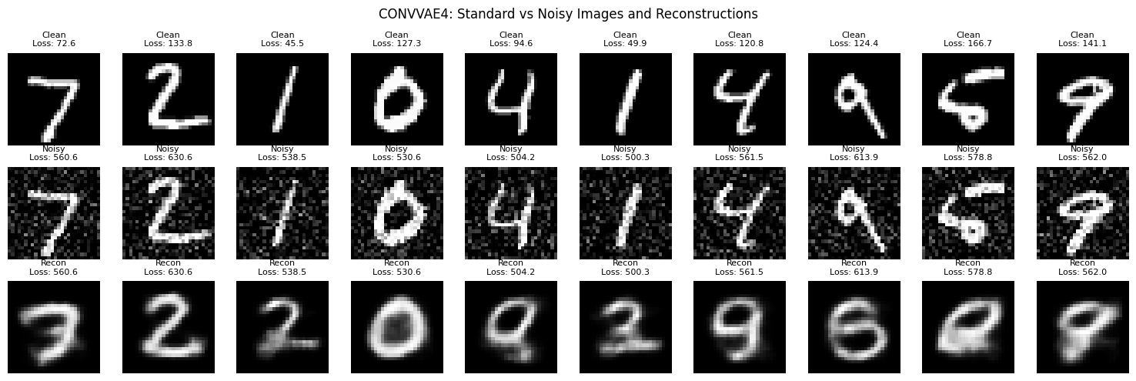
Reconstruction Visualizations: Noisy

Slide 10
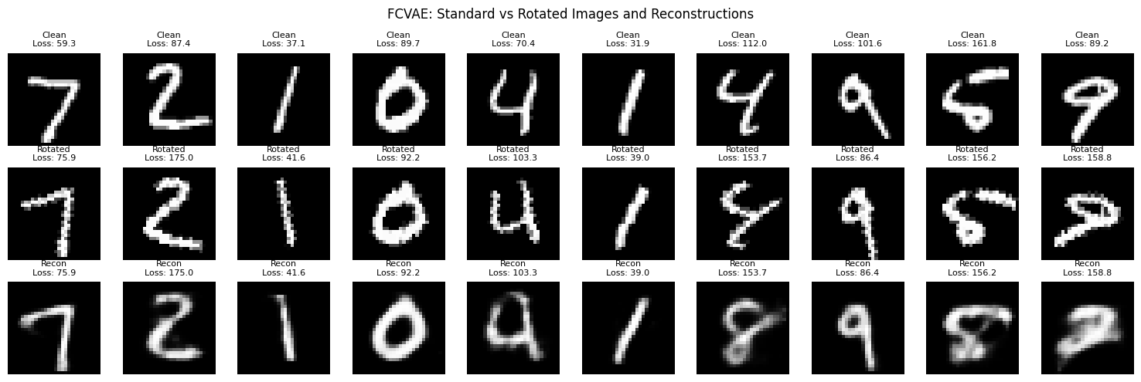
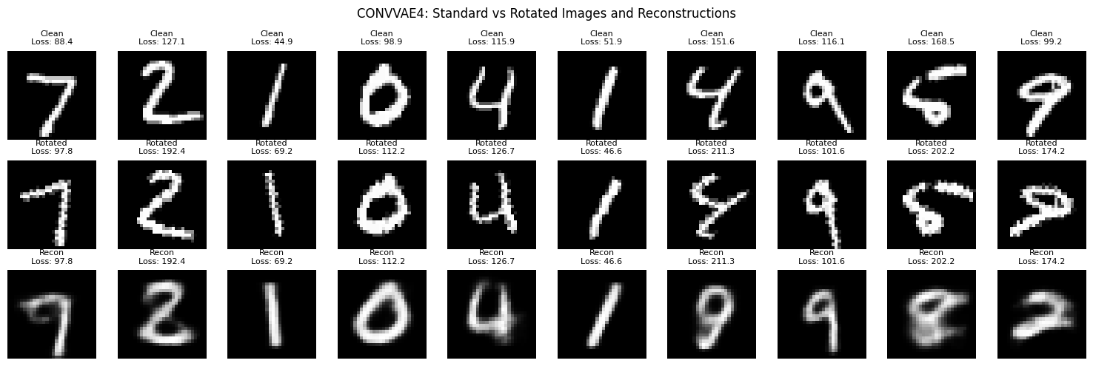
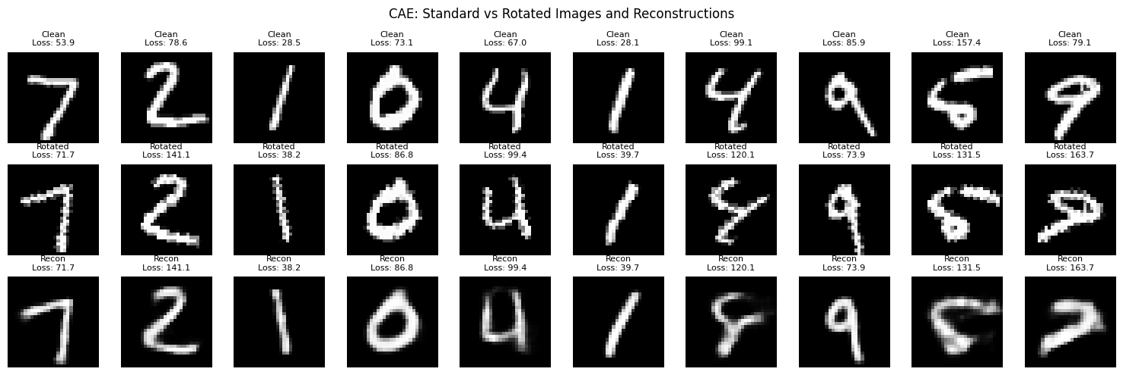
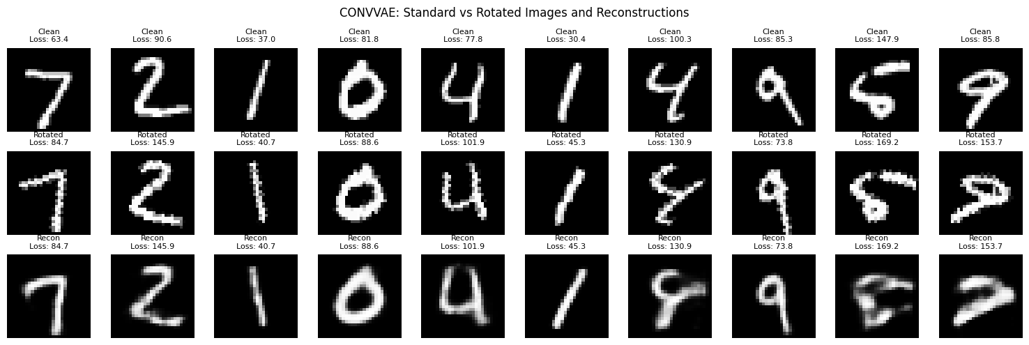
Reconstruction Visualizations: Rotated

Slide 11
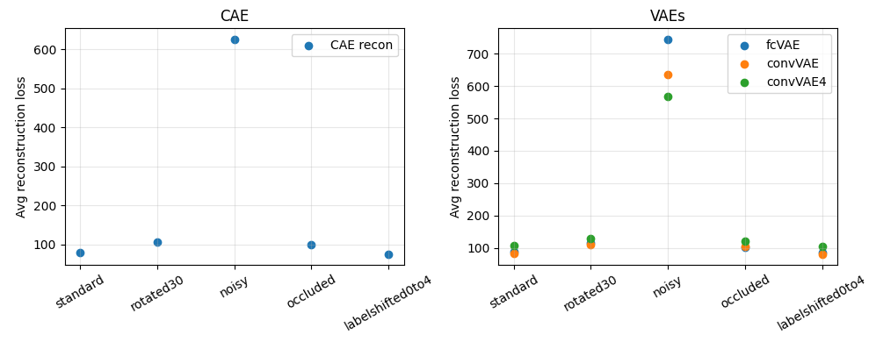
Reconstruction Loss Across Distribution

Slide 12
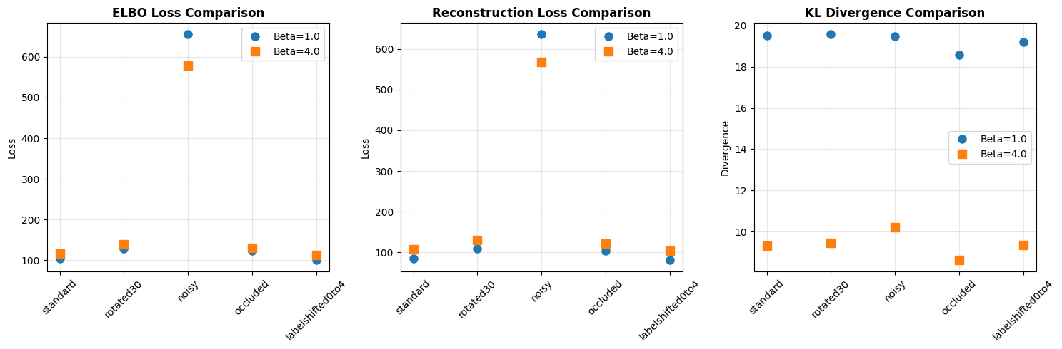
Beta Trade-off for Conv VAE
Key Observations:
Beta=1.0 prioritizes reconstruction quality (generally lower recon loss)
Beta=4.0 prioritizes latent regularization (lower KL divergence)
ELBO loss combines both effects with different weights

Slide 13
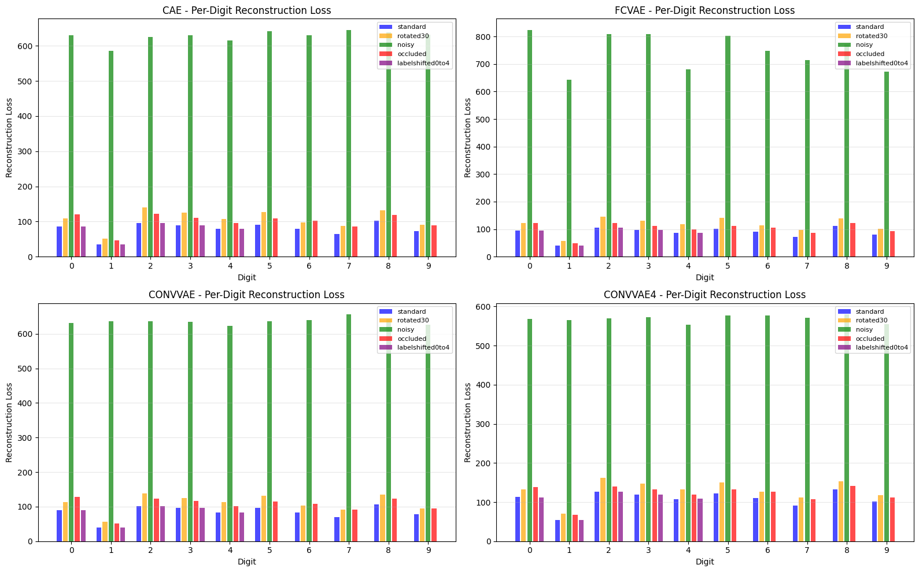
Per-digit performance

Slide 14
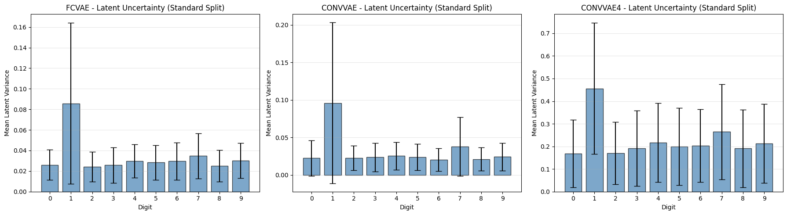
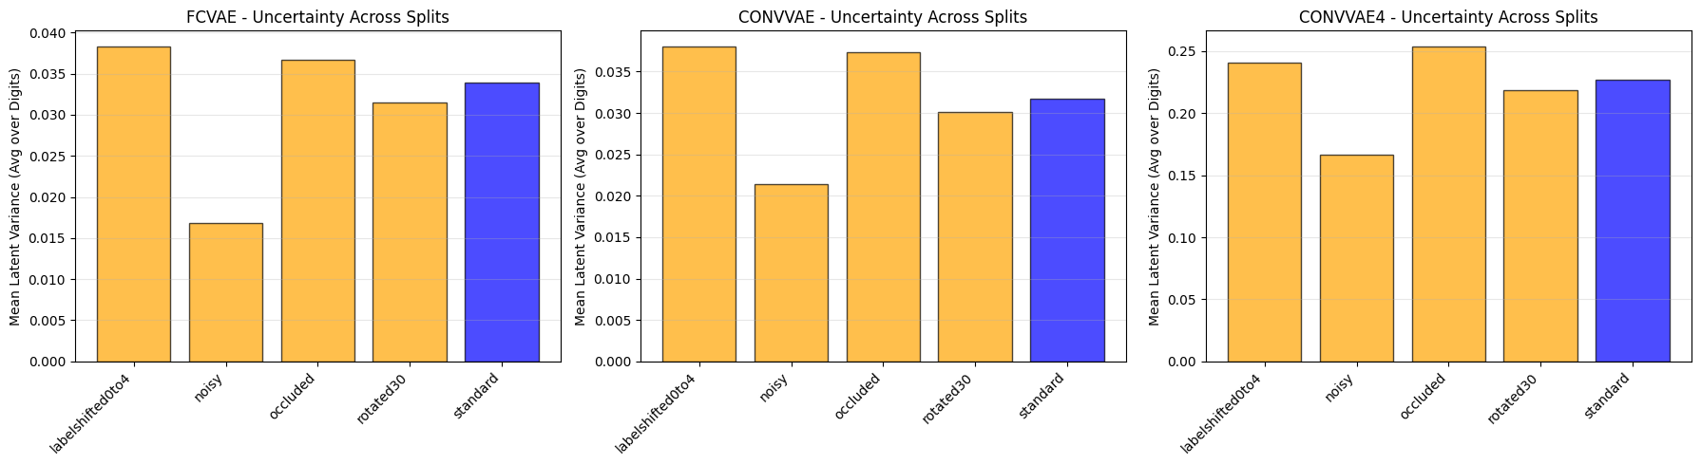
Latent Uncertainty Analysis

Slide 15
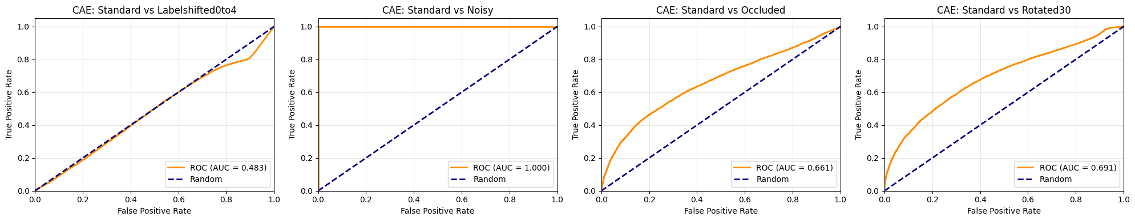
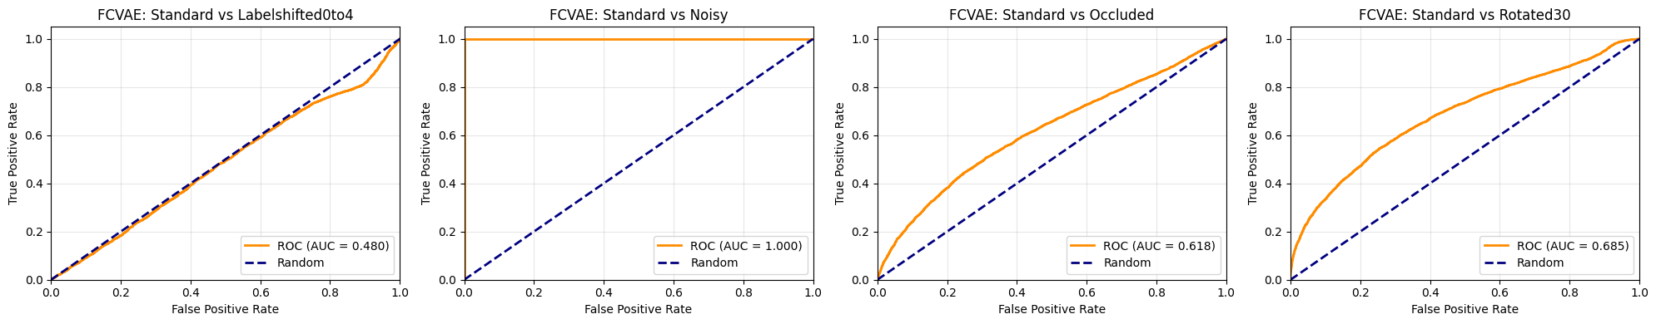
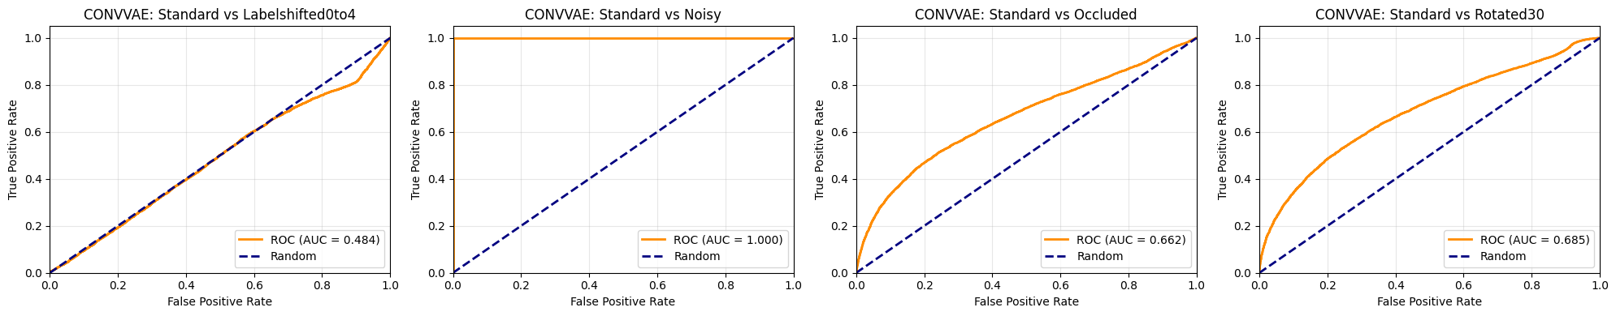
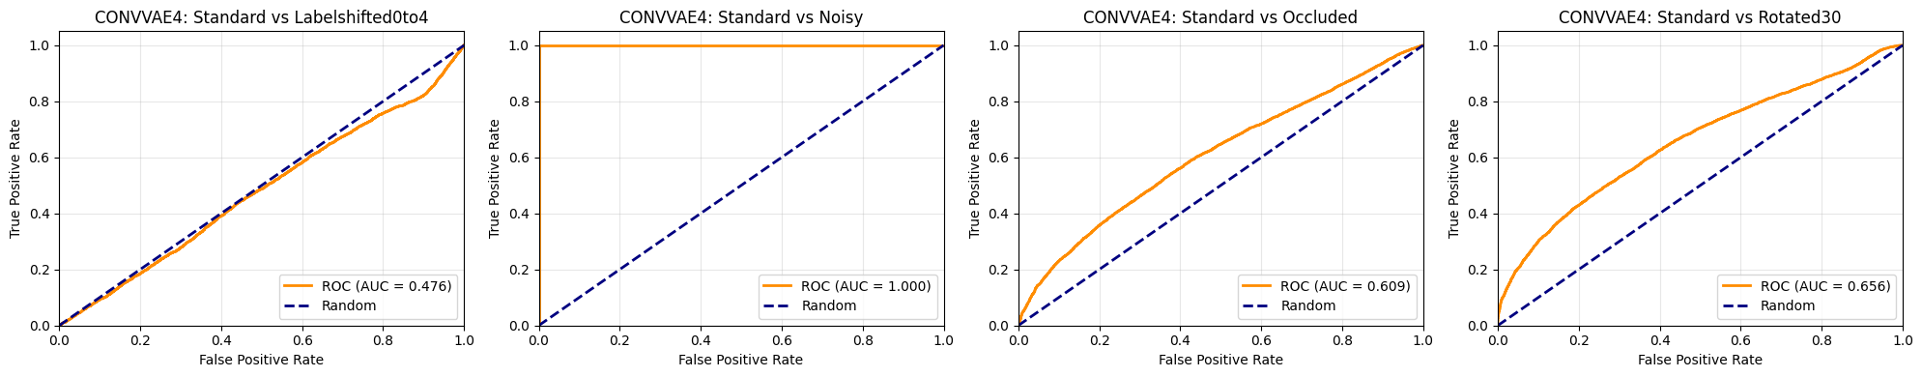
Anomaly Detection

Slide 16
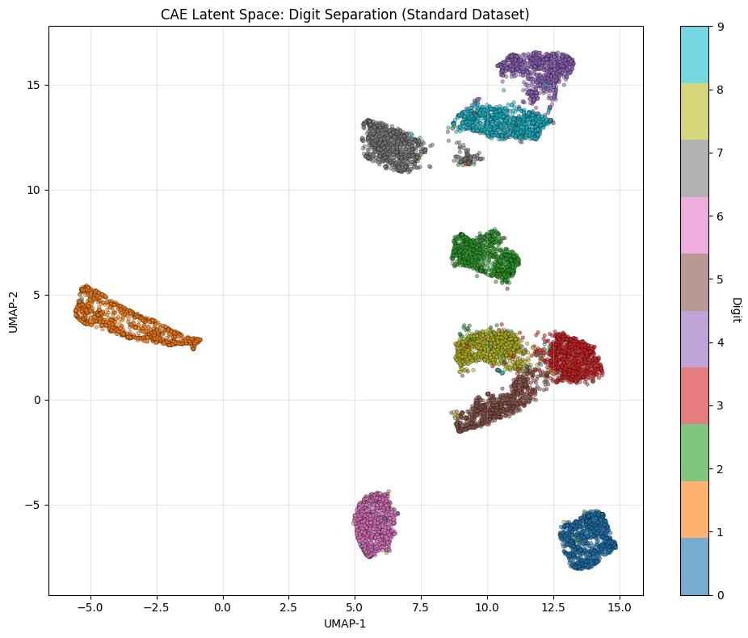
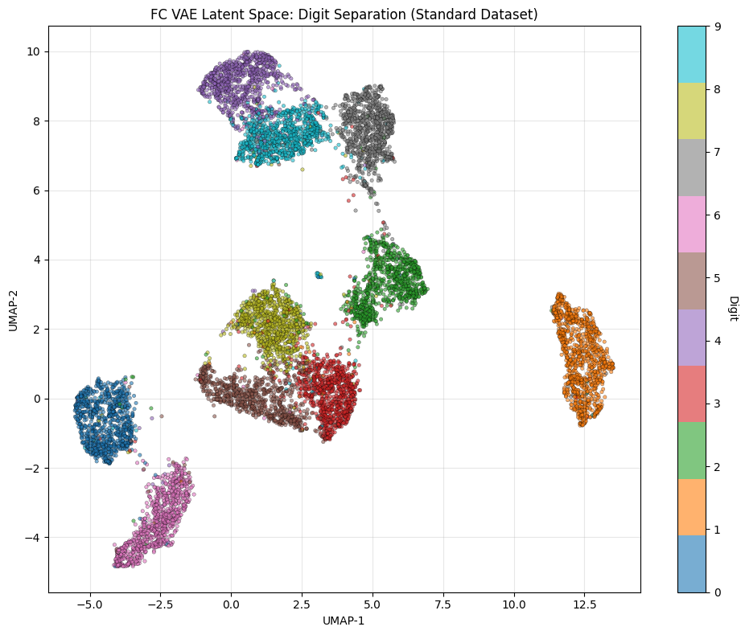
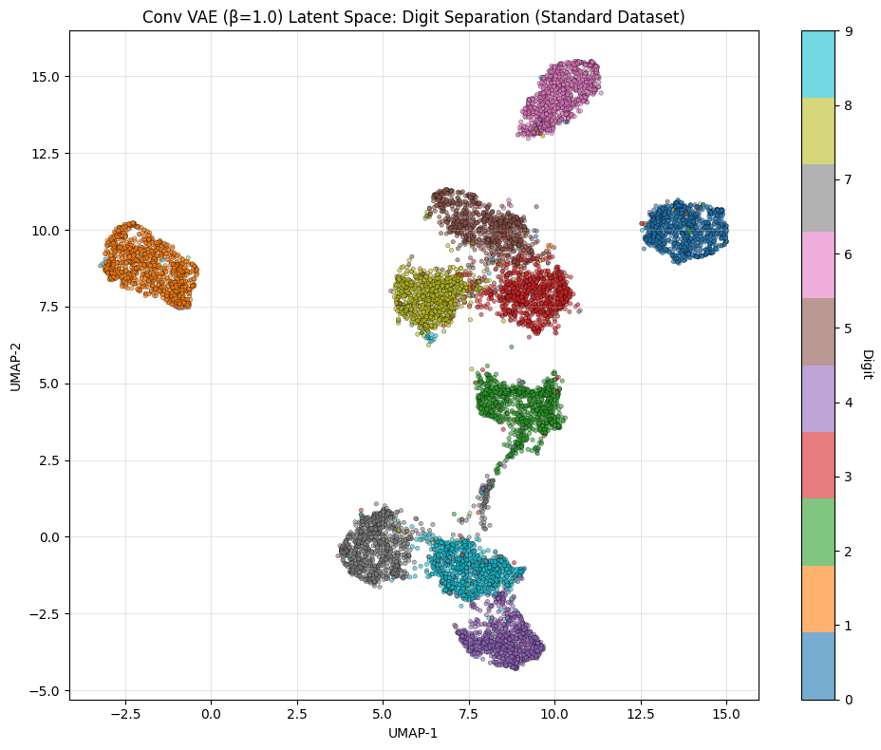
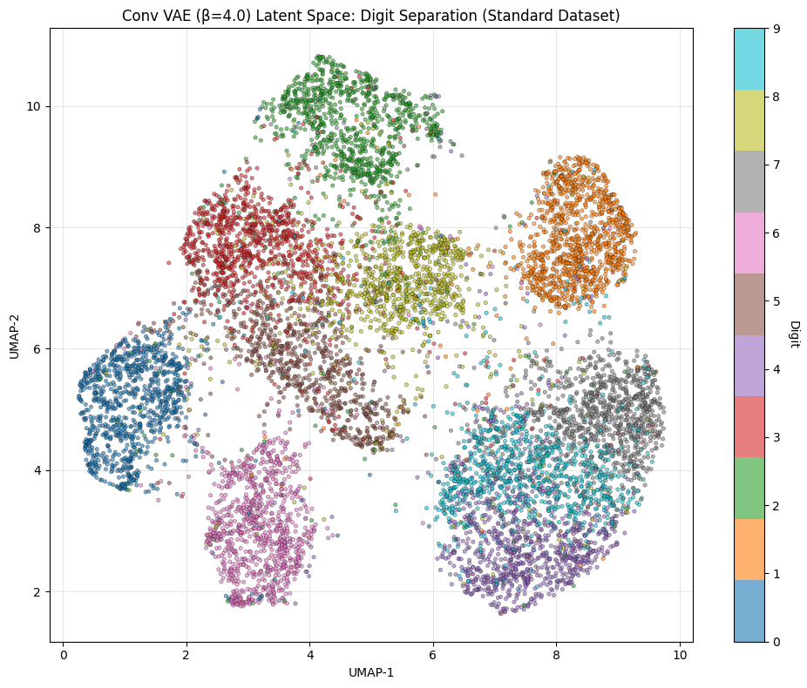
UMAP

Slide 17
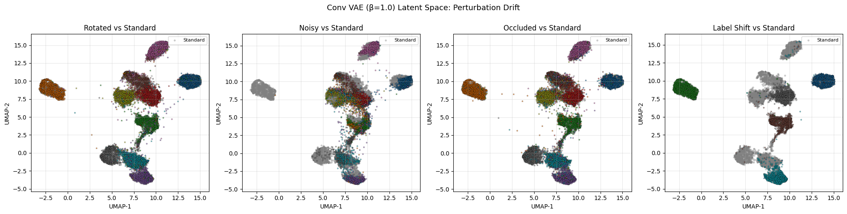
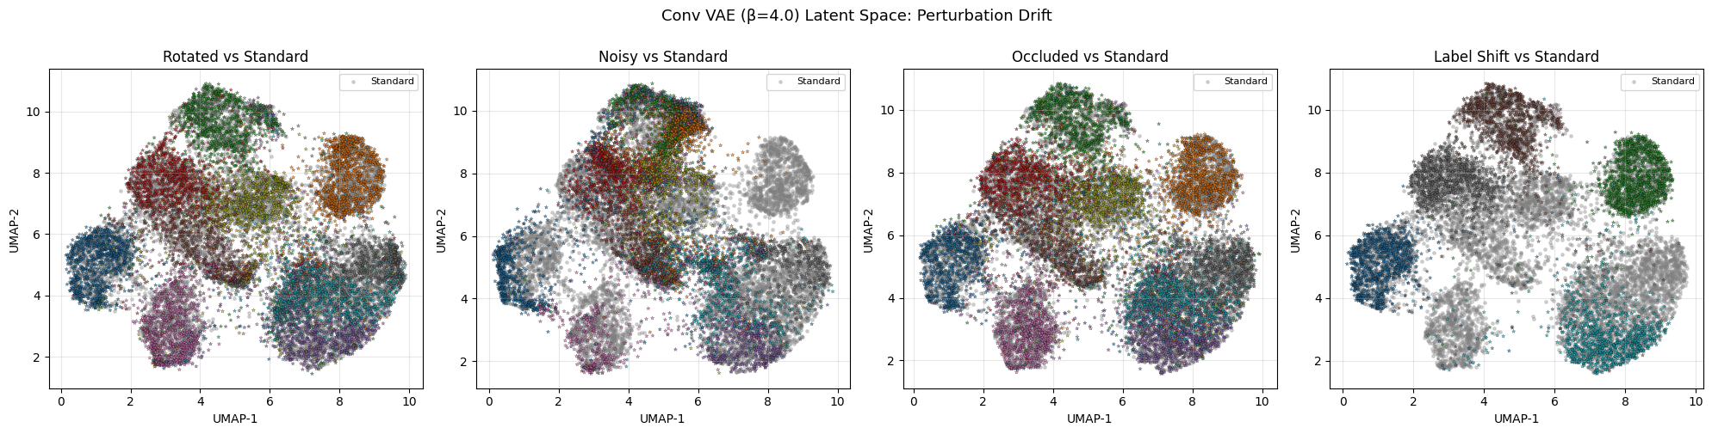
UMAP

Slide 18
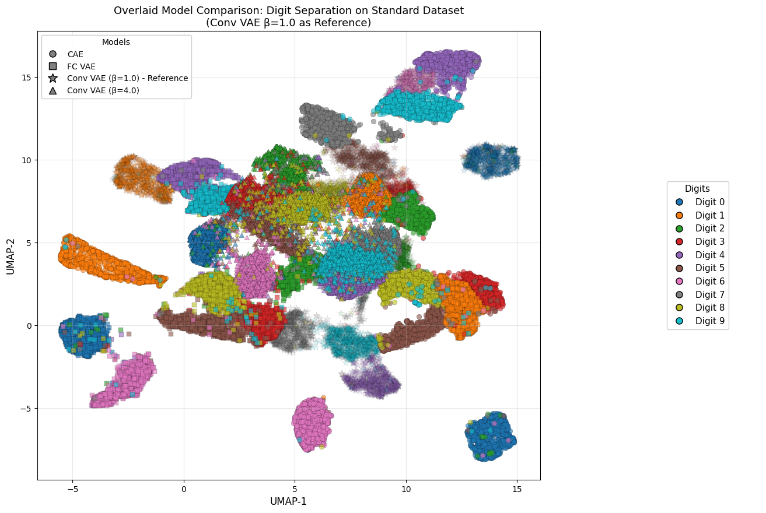
UMAP

